Slide 1


Quick Excel Tutorial
The Very Basics

Slide 2
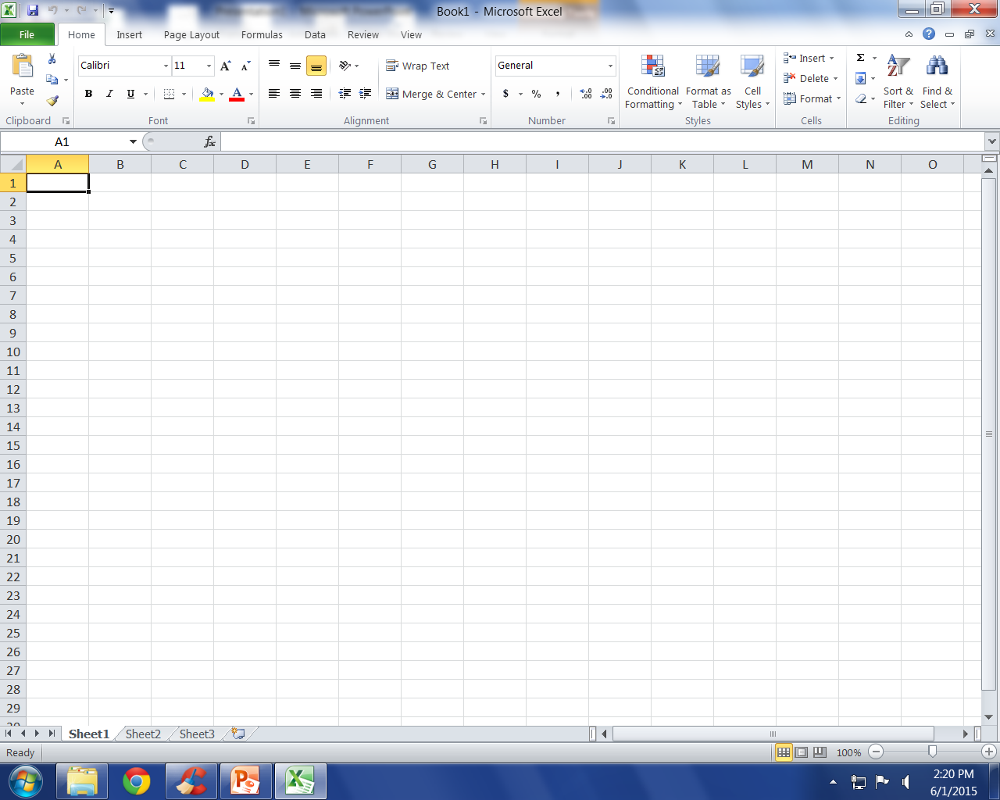
You Are Here.
Notes:
For those of you who have not seen Excel before (or in a while) this is the starting screen.
You’ll recognize some familiar tools on The Ribbon (formerly known as: The Toolbar) across the top.
Copy, Past, Font & size selection, bold italic & underline, text alignment. Then things start to get a bit different.
You now have all kinds of tools for working with spread sheets…which are what we’ll discuss a bit later.
Below all of this you have a standard spread sheet. Each column gets a letter and each row gets a number…basic I know but this is actually very important to know for when we start getting into stuff later.

Slide 3
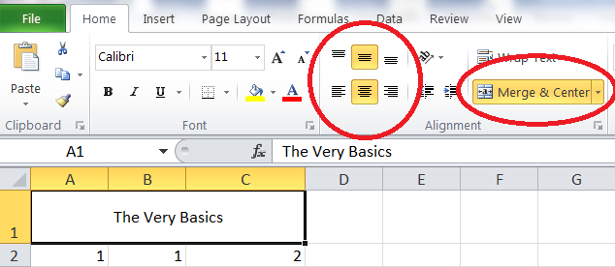
Titles & Column Headers
Merging Cells
Text Alignment
When we work on spread sheets we often need to have a title and/or header clearly visible.
Merge & Center lets us place titles across multiple cells by merging them into one big cell.
This is handy for Titles / category headers.
There is also a handy Unmerge cells option under the down arrow.

Slide 4
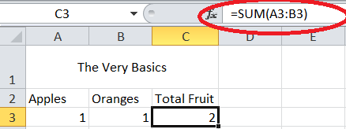
Basic Math
The Magic Math Box
Be where you want the answer to show up
Those column letters and row numbers are necessary for any math.
All math equations are started with an = sign. This lets Excel know you want to do math.
As the little formula box shows we are “SUM”-ing cells A3 & B3 and since we are in cell C3 this is where the answer will show up.

Slide 5
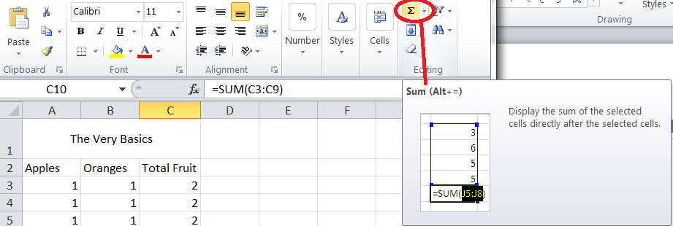

Quick Addition
Say you have along list of numbers you want to add that is where the “Auto Sum” comes in to play.
The little Sigma symbol lets you select a column or row of numbers and adds them up for you….no need to remember cell locations.
Notes:
The Auto Sum symbol also has a pull down menu for auto averages, count numbers, max, min, and more!

Slide 6
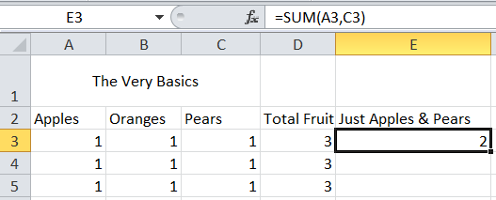
Skipping Things When Adding
When we add across an entire column, or down an entire row we separate the starting and ending cells with a : (colon) and this tells Excel to take everything in-between those two cells.
To skip around in your math you can separate the cell addresses with a , (coma) instead.

Slide 7
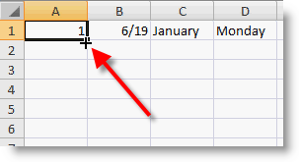

Copying Stuff…
So you don’t have to type as much.
Copy Cross
Click & Move Cross
Excel has a few handy ways to Copy & Move stuff around without messing up your math. (usually)
When you place your mouse cursor on the little black box at the bottom right of the cell you are working in you can click & drag the information in that cell into as many other cells as you like. Formulas are also automatically changed to match the new location.
When you see a cross with four arrows that means you can click and move that cell info to anywhere else in the spread sheet…this moves the cell without copying it.

Slide 8
Other Math Symbols To Use.
Excel is good at math and for those who want to do something besides adding well you just have to remember four symbols.
1. + is add…oops I said not adding.
2. - is subtraction. Yup just like grade school.
3. * is multiplication. X can get to confusing.
4. / is division. Because a sideways L just isn’t on the keyboard.

Slide 9
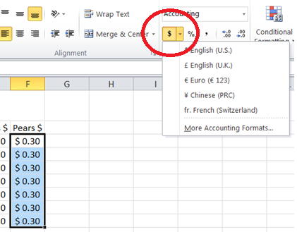
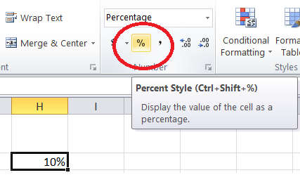
But what if…
I’m working with Money or Percent's
Easy as highlighting what column / row you want to be considered cash and click on the $ symbol on the menu bar…notice it does other currencies too.
For percentages just highlight and click the % symbol and presto your numbers are now percentages.
Notes:
And just incase you were wondering yes all that math works on currencies and percent's correctly too.

Slide 10

The Bottom of the Screen
At the bottom of the screen you can see which worksheet (for accounting folks - ledger page) your are on, and changing between them is as easy as clicking.
Double clicking on the tab lets you rename it anything you’d like.
Before you ask yes you can do math across sheets, but that’s probably a little to complicated for today’s discussion.

Slide 11
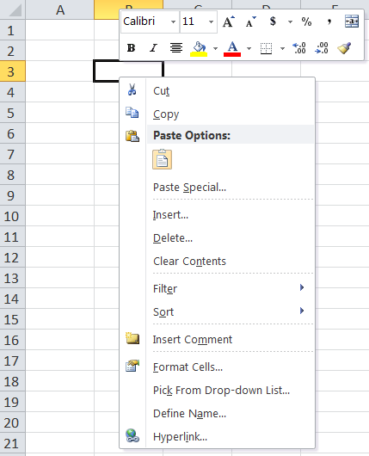
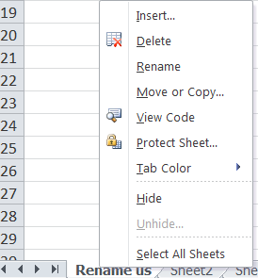
When in doubt – Right Click
Right clicking the mouse brings up alternative option menus…these menus vary depending on where you are.
They have some pretty handy options that save you from hunting down the right button on the tool bar.

Slide 12
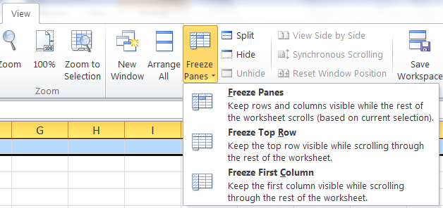
Freeze Panes. Aka Keeping your headings or other important info visible at all times
Way over to the right, under the “View” tab there is an option to “Freeze Panes”.
This option allows you to keep a row or column visible no matter how far your scroll / move away from it.
This is really handy for long or wide spreadsheets.

Slide 13
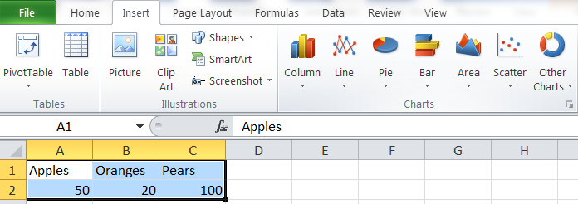
A not so basic tool: Charts & Graphs
Lastly Excel has a very easy to use chart / graph feature.
You simply highlight what you want as part of your graph / chart.
Then Under “Insert” choose the style graph you want.

Slide 14
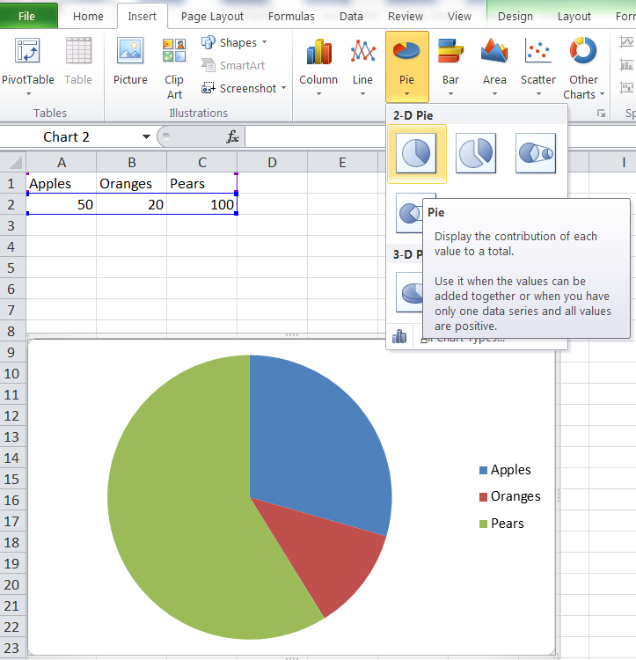
And Presto you Have a Chart / Graph
Notes:
You can edit this graph as much as you’d like afterward too.
Also if you change your numbers later the graph automatically changes.

Slide 15
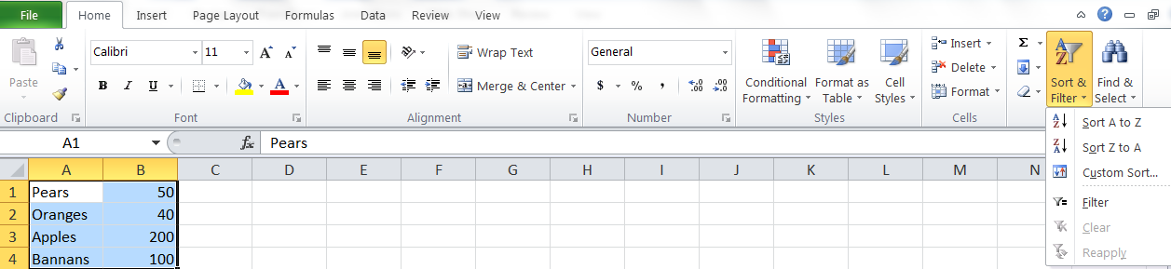
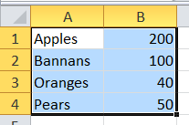
Lastly we’ll talk about Sorting
Sorting come’s in really handy with long lists.
Simply choose how you want to sort your list. (A-Z or Z-A) and click it.
Presto your list is sorted

Slide 16
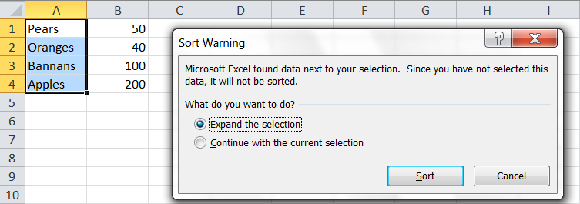
Sort Warning
One warning about Sorting.
You can (if you choose) sort just one column / row of data
This means that anything related to that data in an adjacent column/row won’t follow the sort…this can really mess up your data so be careful and pay attention to the Sort Warnings.

Slide 17



I think that covers the Excel Basics
Any Questions?

